Slide 1
6. Neural
audio compression
Xavier Serra

Slide 2
Index
SoundStream and EnCoded systems
Convolutional Neural Networks (CNN)
Convolutional Auto Encoder (CAE)
Implementation (Pytorch)
Challenges in Deep Learning for Audio Coding

Slide 3
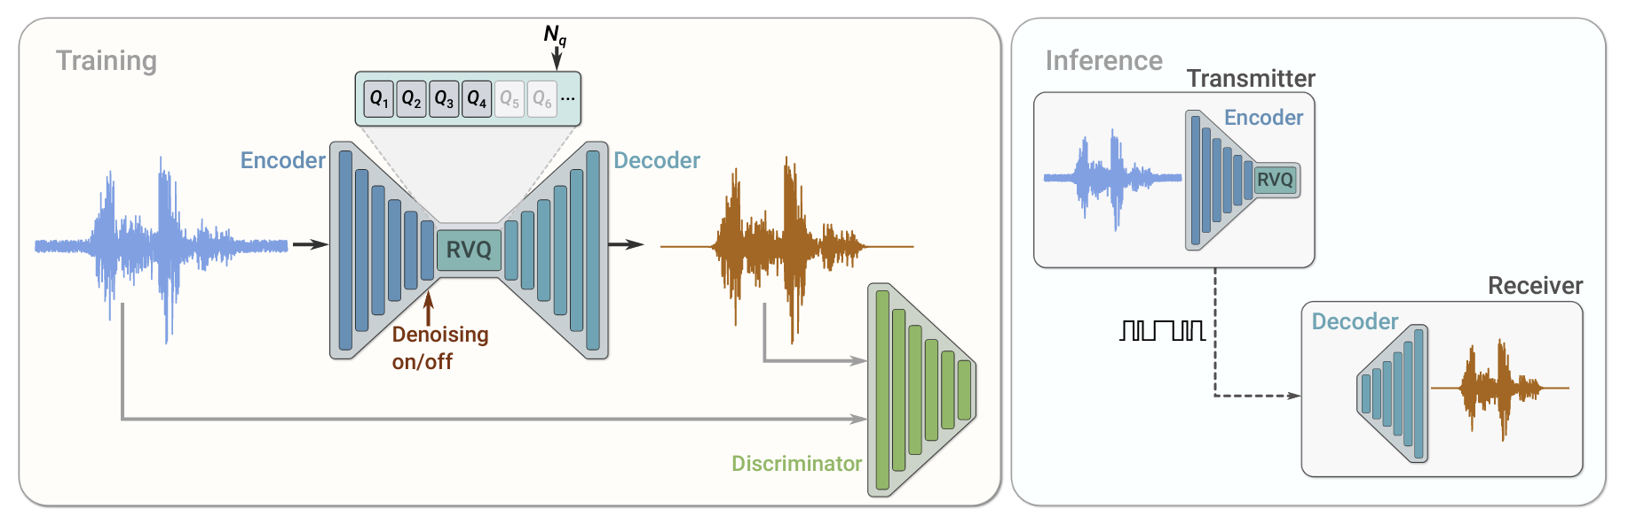
SoundStream
A convolutional encoder produces a latent representation of the input audio simples, which is quantized using a variable number of residual vector quantizers (RVQ). During training, the model parameters are optimized using a combination of reconstruction and adversarial losses.

Slide 4
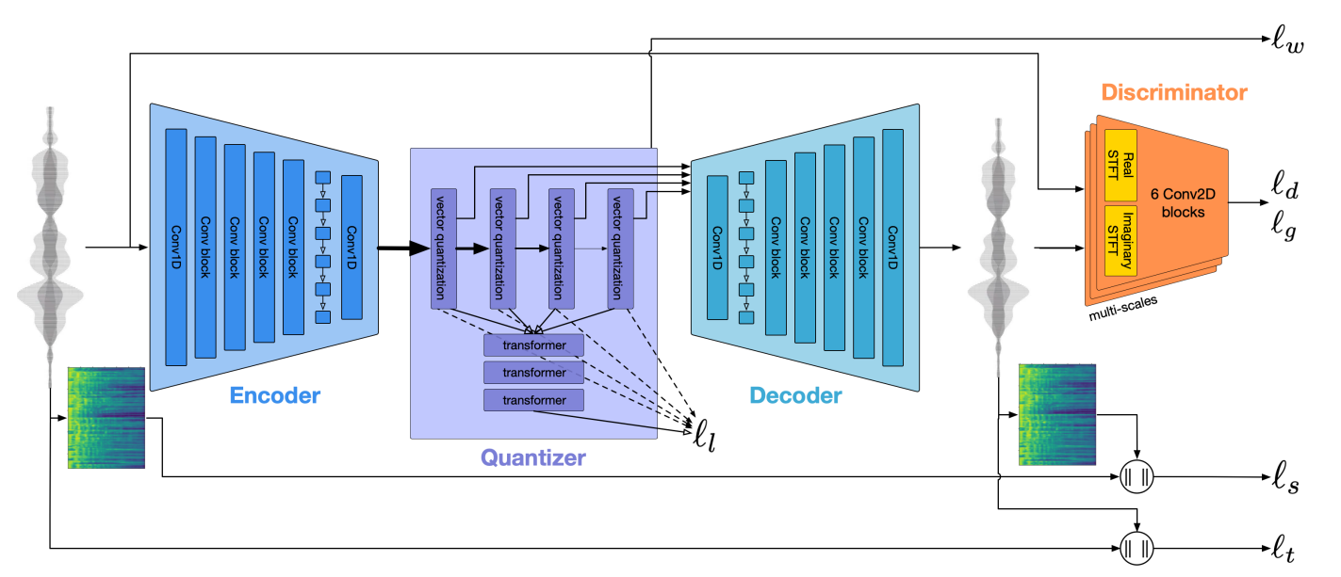
Encodec
75 Hz
Key component
24000 Hz
RNN

Slide 5
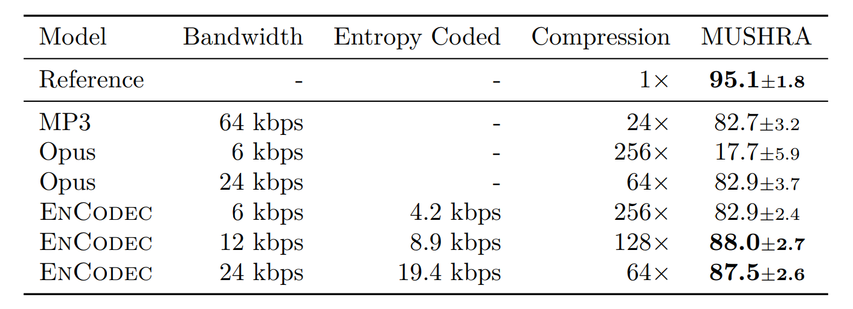
Results

Slide 6
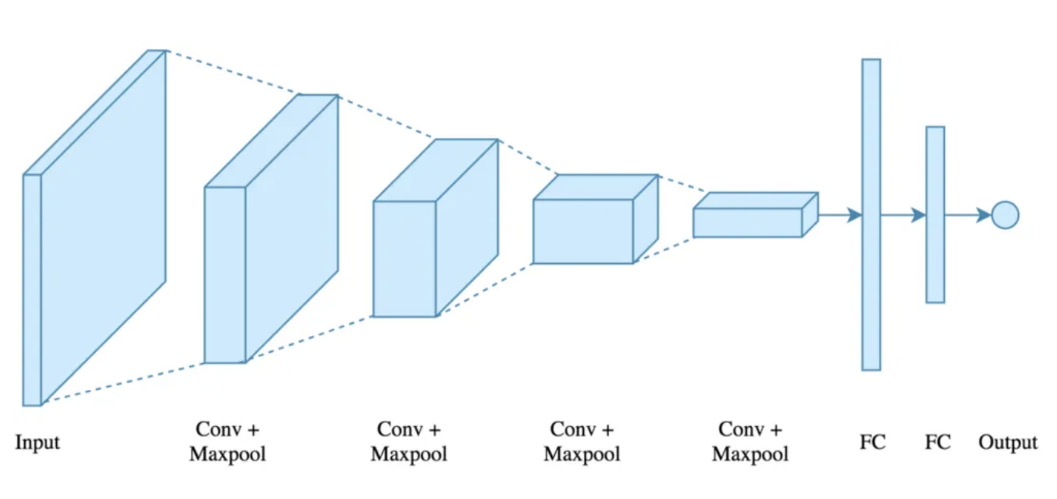
Convolutional Neural Networks (CNN)
CNNs are used to detect patterns and structures in data.
Originally developed for images, but widely applied to audio.
Key strength: automatic feature extraction (from low-level to high-level).

Slide 7
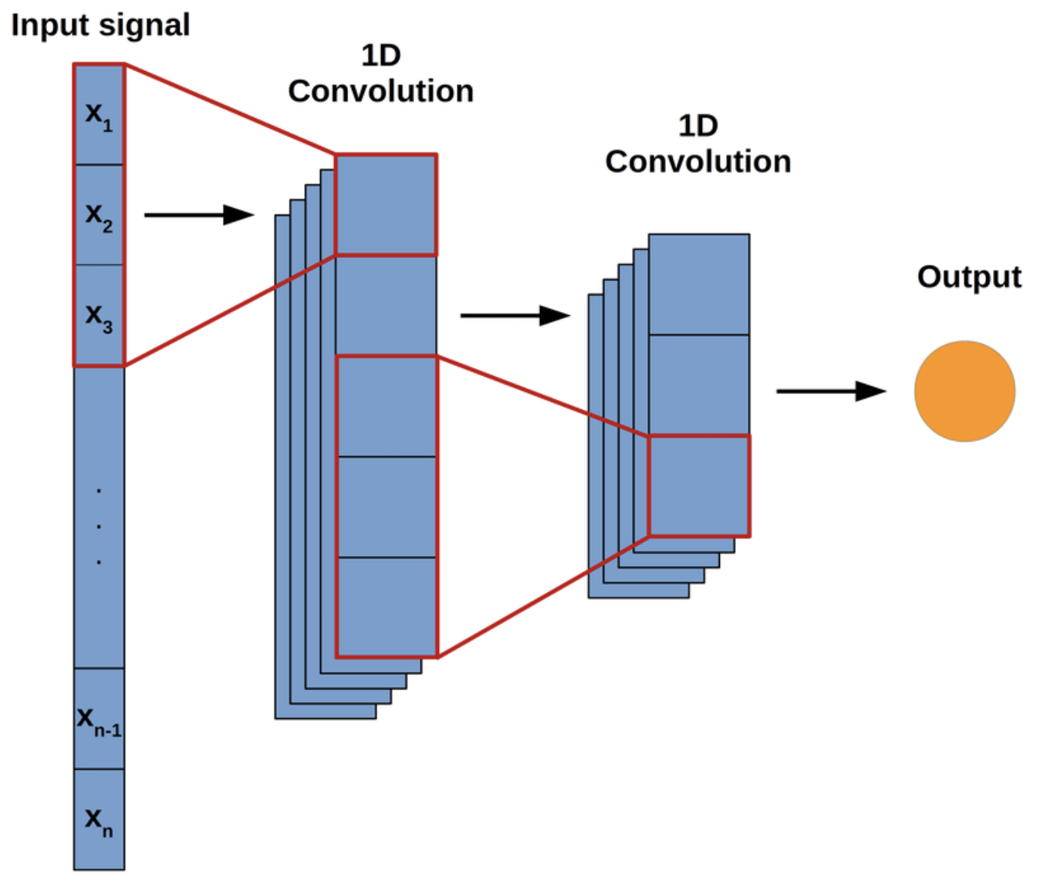
What is Convolution?
Convolution is a mathematical operation between a filter (kernel) and the input signal.
The filter slides over the input and extracts features by applying a weighted sum.
CNNs learn the filters (unlike traditional signal processing, where filters are predefined).

Slide 8
Kernels and Feature Detection
Kernels (or filters) are small-sized matrices (e.g., 3x3, 5x5) that detect specific features in the input.
Different filters detect different patterns (e.g., low-frequency vs. high-frequency components in audio).
Filters are learned from the data during training.

Slide 9
Stride and Padding in CNNs
Stride: Defines how much the filter moves across the input (affects output size).
Padding: Adds extra space around the input (e.g., zero-padding) to control output size and maintain important boundary information.

Slide 10
Convolutional Layer: Extracting Features
A convolutional layer applies multiple filters to the input, producing feature maps.
Each feature map highlights a specific pattern (e.g., rhythm, timbre, harmonic structure).
Multiple convolutional layers are stacked to capture progressively more complex patterns.

Slide 11
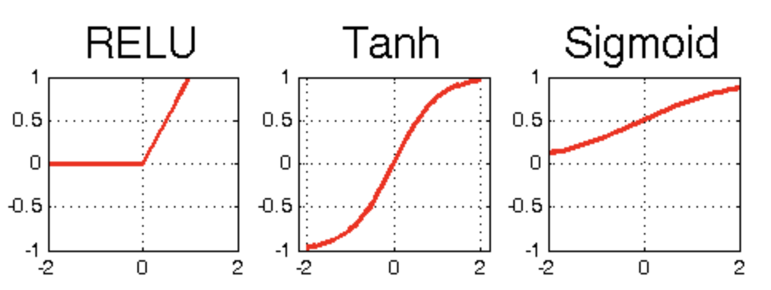
Non-Linear Activation Functions (ReLU)
Activation functions introduce non-linearity, allowing the model to learn complex representations.
Commonly used: Rectified Linear Unit (ReLU) – keeps positive values, zeroes out negative values.

Slide 12
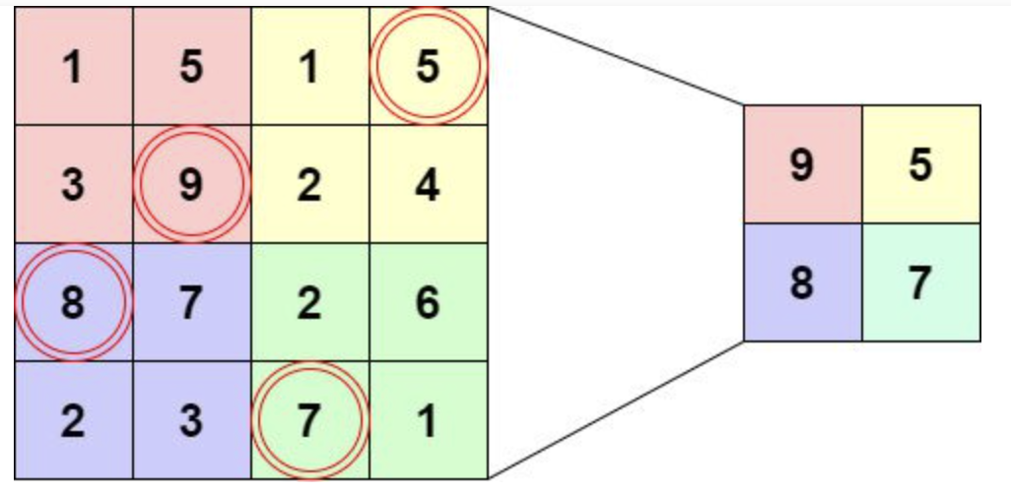
Pooling Layer: Downsampling the Data
Pooling reduces the size of the feature maps while retaining important information.
Common type: Max-pooling – takes the maximum value in a window, reducing dimensionality.
Helps make the model more efficient and less sensitive to minor shifts.

Slide 13
How CNNs Build Hierarchical Representations
Multiple layers of convolutions and pooling allow CNNs to learn increasingly abstract representations.
Early layers learn simple features (e.g., edges, transients), while deeper layers learn complex features (e.g., melodies, harmonics).
CNNs are trained end-to-end: from raw audio to compressed representation or output.

Slide 14
CNNs vs. Traditional Audio Filters
Traditional methods use predefined filters (e.g., Fourier, filter-banks) for feature extraction.
CNNs learn the filters directly from the data, making them more adaptable and task-specific.
CNNs can achieve better compression by optimizing for the specific characteristics of the input audio.

Slide 15
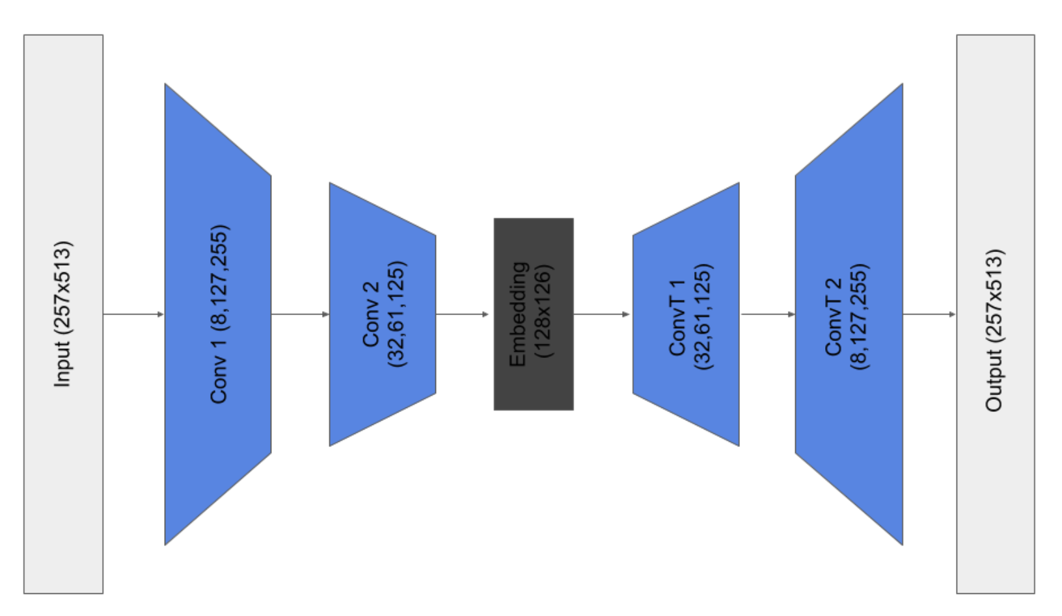
Convolutional Auto Encoder (CAE)
A type of neural network used for unsupervised learning.
Two parts: Encoder (compresses data) and Decoder (reconstructs data).
Purpose in audio: learn compact representations of audio signals for compression.

Slide 16
How the Encoder Works in Audio Compression
The Encoder is a series of convolutional layers that compresses the input audio into a lower-dimensional representation.
CNN layers learn to extract important features (e.g., harmonics, transients) while reducing redundancy.
The final output of the encoder is a bottleneck: a highly compressed version of the input.

Slide 17
How the Decoder Works in Audio Compression
The Decoder is the inverse of the encoder: a series of transposed convolutional layers that upsample the compressed data to reconstruct the original audio.
The goal is to reconstruct the audio signal as accurately as possible from the compressed representation.
The success of the decoder depends on how well the encoder captured the essential features of the audio.

Slide 18
Understanding the Bottleneck: The Key to Compression
The bottleneck layer is the most critical part of the autoencoder, where compression happens.
The size of the bottleneck determines the compression ratio: smaller bottleneck -> higher compression, but at the risk of losing important audio details.
Finding the right balance between compression rate and audio quality is key.

Slide 19
Training the Autoencoder: Loss Function and Optimization
The autoencoder is trained to minimize the difference between the original input and the reconstructed output (reconstruction error).
Common loss functions: Mean Squared Error (MSE) for signal differences, and perceptual loss for quality-based reconstruction.
The autoencoder is optimized using backpropagation and gradient descent.

Slide 20
Gradient descent and learning rate
Gradient descent is an optimization algorithm used in machine learning and deep learning to minimize the loss function and improve model accuracy. The basic idea behind gradient descent is to iteratively adjust the model's parameters (weights and biases) in the direction that reduces the loss function, helping the model better fit the training data.
The learning rate is a crucial hyperparameter in machine learning, particularly in training neural networks. It controls the size of the steps that the optimization algorithm (usually gradient descent or a variant) takes when adjusting the model's weights to minimize the loss function.

Slide 21
Pytorch
An open-source machine learning framework that provides a flexible and efficient platform for building and training deep learning models. It has become one of the most popular deep learning frameworks due to its flexibility, Pythonic interface, and extensive support for GPUs (Graphics Processing Units), which are crucial for accelerating deep learning computations.

Slide 22
Challenges
Data requirements
Generalization
Real-Time Audio Coding

Slide 23
References
Neil Zeghidour, Alejandro Luebs, Ahmed Omran, Jan Skoglund, Marco Tagliasacchi. 2021. "SoundStream: An End-to-End Neural Audio Codec".
Alexandre Défossez, Jade Copet, Gabriel Synnaeve, Yossi Adi. 2022. "High Fidelity Neural Audio Compression".

